Slide 1


Eric John Sulit
March 30, 2023

Slide 2

Outline
Executive Summary
Introduction
Methodology
Results
Conclusion
Appendix

Slide 3
Executive Summary
Summary of methodologies
Data Collection
Data Wrangling
EDA with Data Visualization
EDA with SQL
Building an interactive map with Folium
Building a dashboard with Plotly Dash
Predictive analysis (Classification)
Summary of all results
EDA results
Interactive analysis
Predictive analysis

Slide 4
Introduction
Project background and context
SpaceX advertises Falcon 9 rocket launches on its website, with a cost of 62 million dollars; other providers cost upward of 165 million dollars each, much of the savings is because SpaceX can reuse the first stage.
Problems you want to find answers
The project task is to predict if the first stage of the SpaceX Falcon 9 rocket will land successfully.

Slide 5

Section 1

Slide 6
Methodology
Executive Summary
Data collection methodology:
SpaceX Rest API
Web Scrapping from Wikipedia
Perform data wrangling
One Hot Encoding data fields for Machine Learning and data cleaning of null values and irrelevant columns
Perform exploratory data analysis (EDA) using visualization and SQL
Perform interactive visual analytics using Folium and Plotly Dash
Perform predictive analysis using classification models
LR, KNN, SVM, DT models have been built and evaluated for the best classifier

Slide 7
Data Collection
SpaceX API
Web Scrapping
The following datasets was collected:
SpaceX launch data that is gathered from the SpaceX REST API.
This API will give us data about launches, including information about the rocket used, payload delivered, launch specifications, landing specifications, and landing outcome.
The SpaceX REST API endpoints, or URL, starts with api.spacexdata.com/v4/.
Another popular data source for obtaining Falcon 9 Launch data is web scraping Wikipedia using BeautifulSoup.
Use SpaceX REST API
Use SpaceX REST API
Return SpaceX Data In JSON
Extract Data using Beautiful Soup
Normalize Data into CSV File
Normalize Data into CSV File
Return SpaceX Data In JSON

Slide 8
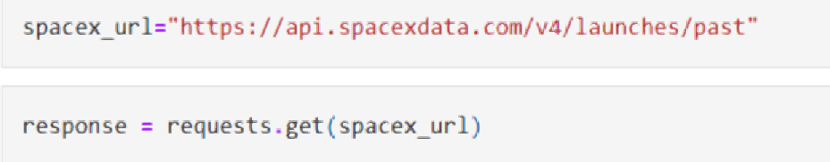


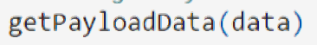
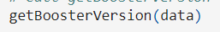
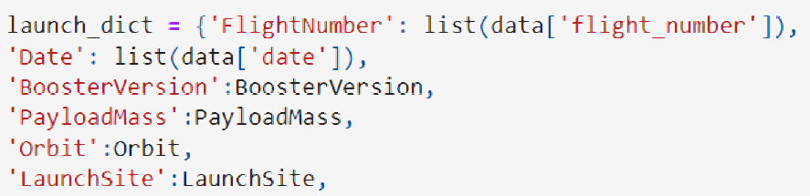
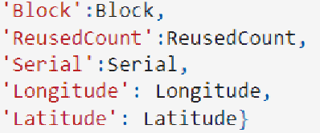
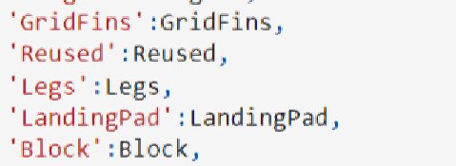
Data Collection – SpaceX API
Response From API
Getting Response to a JSON file
Apply Custom Function to Clean Data
Assign List to Dictionary then Dataframe
Filter Dataframe and Export to Flat File (.csv)
Data collection with SpaceX REST calls
URL: https://github.com/ericjohn05/testrepo/blob/master/Final_Assignment.ipynb

Slide 9
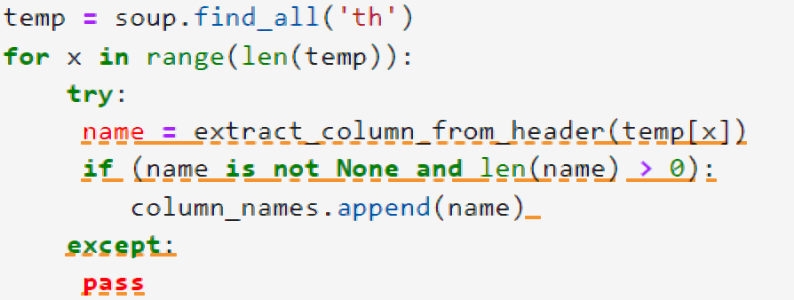
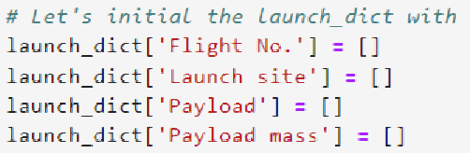
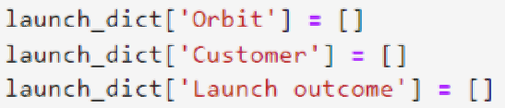
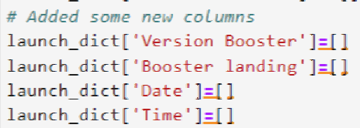
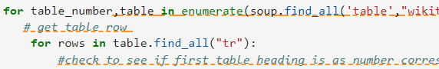
Data Collection - Scraping
Getting Response from HTML
Creating BeautifulSoup Object
Finding Tables
Getting Column Names
Creation of Dictionary
Appending Data to Keys
Converting Dictionary to Dataframe
Dataframe to .CSV
Web Scrapping From Wikipedia
URL: https://github.com/ericjohn05/testrepo/blob/master/jupyter-labs-webscraping%20(1).ipynb

Slide 10
Data Wrangling
EDA Analysis
URL: https://github.com/ericjohn05/testrepo/blob/master/labs-jupyter-spacex-Data%20wrangling.ipynb
Check Null Values
Calculate the Number of Launches on each sites
Calculate the Number and occurence of each orbit
Handle Null Values
Create a landing outcome label from outcome column
Calculate the Number and occurrence of mission outcome per Orbit Type

Slide 11
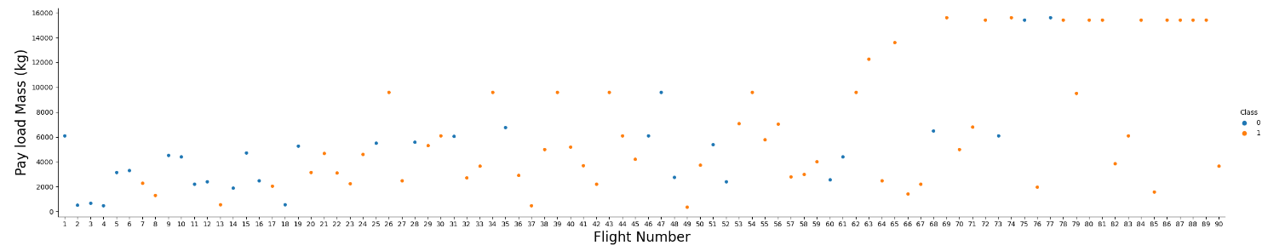
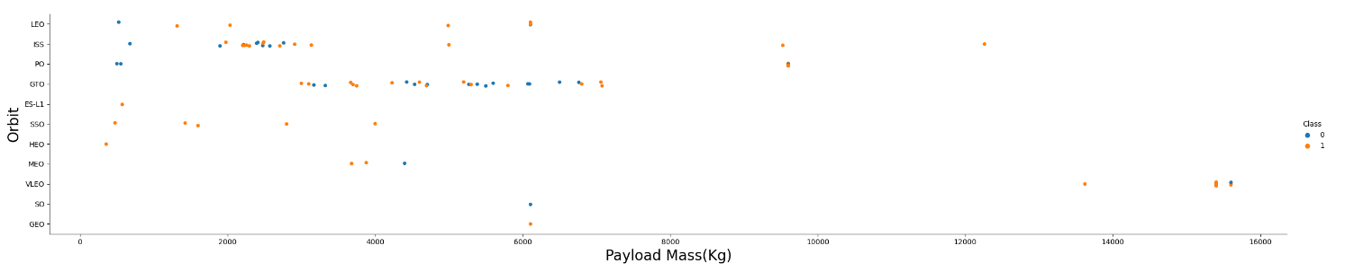
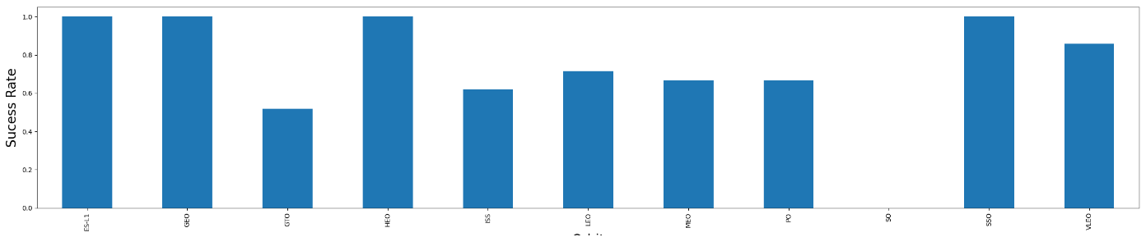
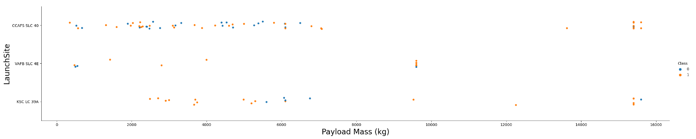
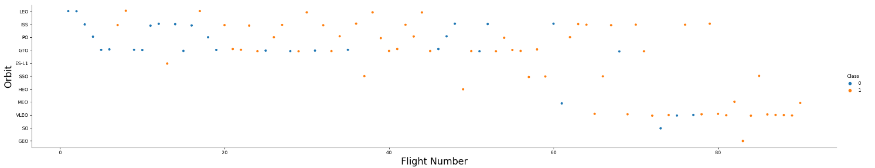
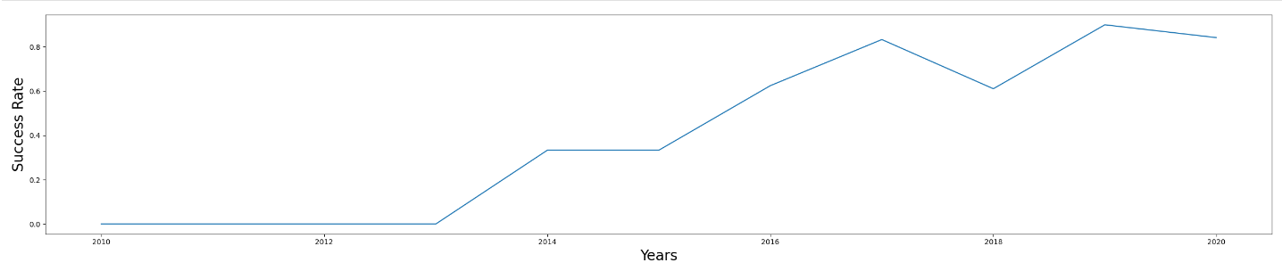
EDA with Data Visualization
URL: https://github.com/ericjohn05/testrepo/blob/master/jupyter-labs-eda-sql-edx%20(1).ipynb

Slide 12
EDA with SQL
SQL queries performed include:
Displaying the names of the unique launch sites in the space mission
Displaying 5 records where launch sites begin with the string ‘KSC’
Displaying the total payload mass carried by boosters launched by NASA (CRS)
Displaying average payload mass carried by booster version F9 v1.1
Listing the date where the successful landing outcome in drone ship was achieved.
Listing the names of the boosters which have success in ground pad and have payload mass greater than 4000 but less than 6000
Listing the total number of successful and failure mission outcomes
Listing the names of the booster_versions which have carried the maximum payload mass.
Listing the records which will display the month names, successful landing_outcomes in ground pad, booster
Versions, launch_site for the months in year 2017
Ranking the count of successful landing_outcomes between the date 2010 06 04 and 2017 03 20 in descending order.
URL: https://github.com/ericjohn05/testrepo/blob/master/jupyter-labs-eda-sql-edx%20(4).ipynb

Slide 13
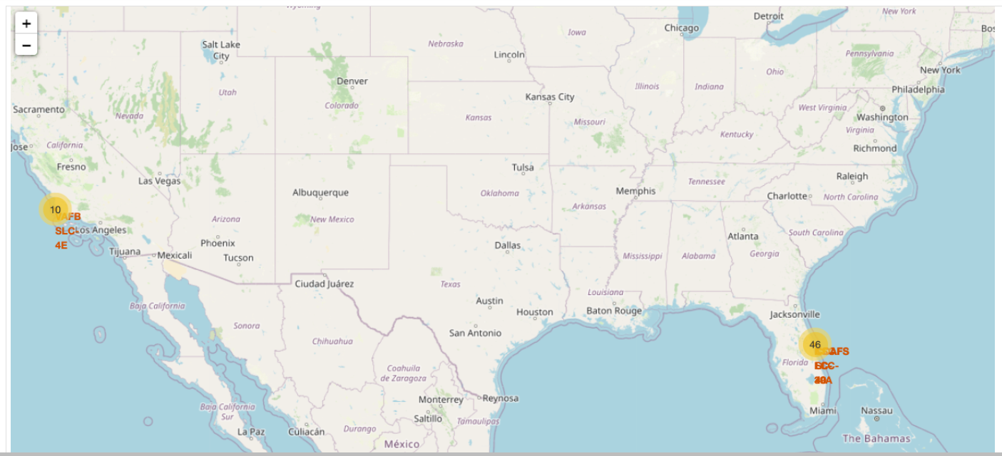
Build an Interactive Map with Folium
Map marker have been added to the map with aim to finding an optional location for building a launch site URL: https://github.com/ericjohn05/testrepo/blob/master/IBM-DS0321EN-SkillsNetwork_labs_module_3_lab_jupyter_launch_site_location.jupyterlite%20(1).ipynb

Slide 14
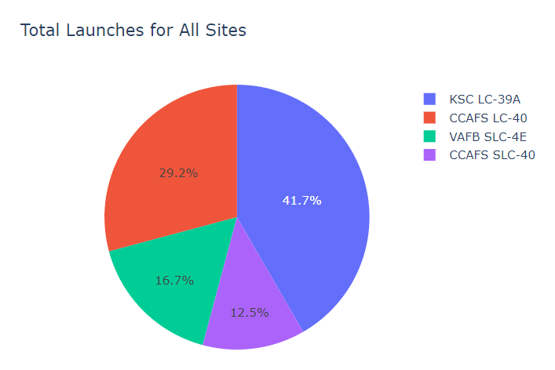
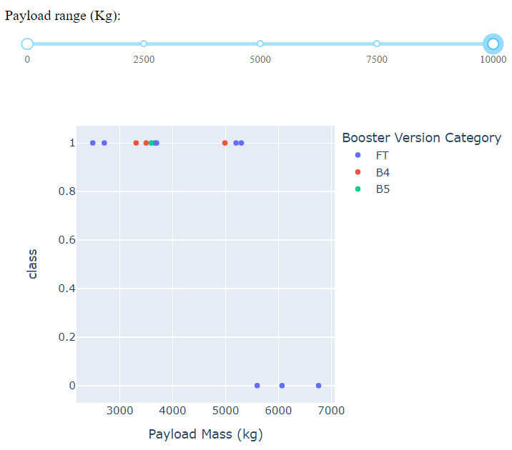
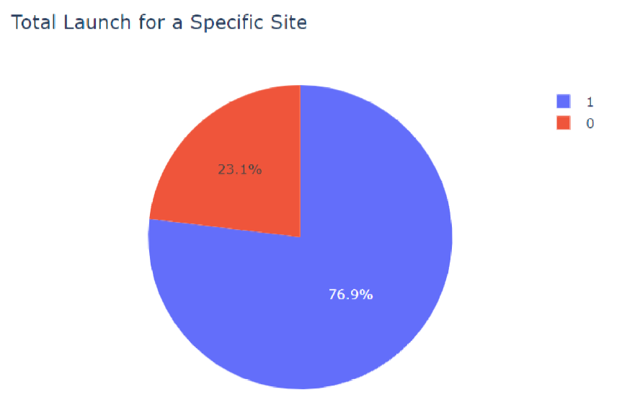
Build a Dashboard with Plotly Dash
URL: https://github.com/ericjohn05/testrepo/blob/master/spacex_dash_app%20(1).py
We can see that KSC LC-39A had the most successful launches from all the sites
KSC LC-39A achieved a 76.9% success rate while getting a 23.1% failure rate

Slide 15
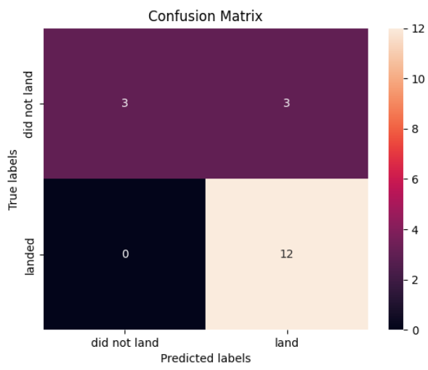
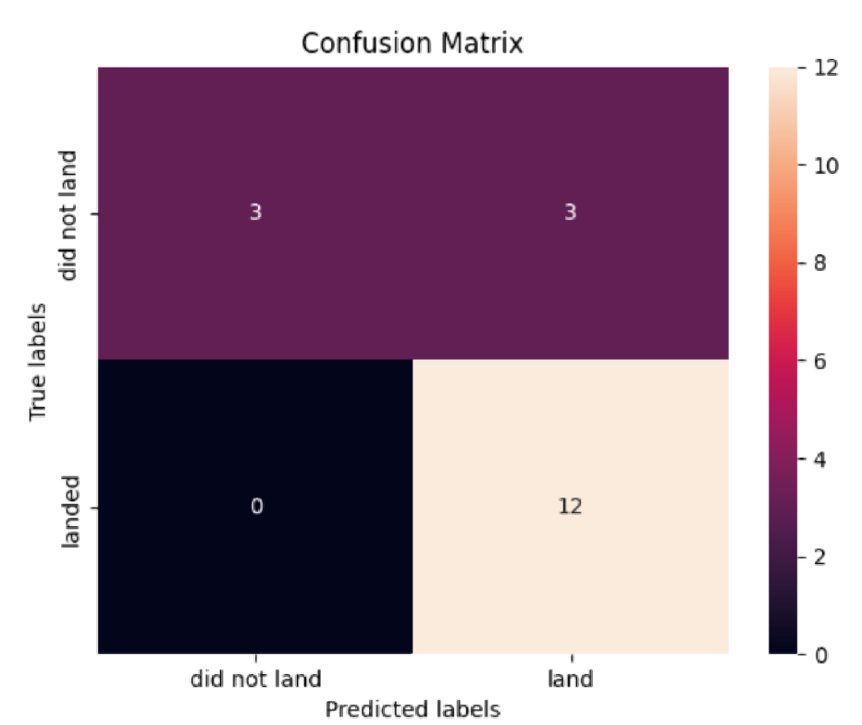
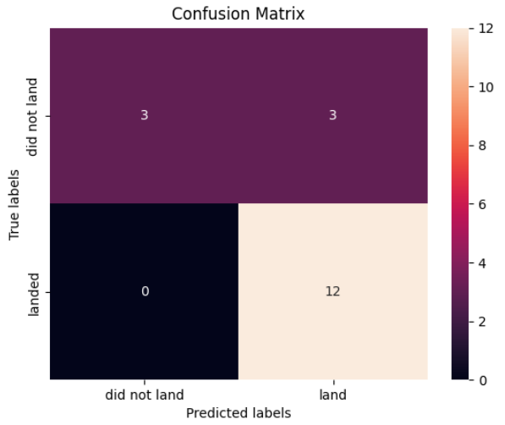

Predictive Analysis (Classification)
The SVM, KNN, and Logistic Regression model achieved the highest accuracy at 83.3% , while the SVM performs the best in terms of Area Under the Curve at 0.958.
URL: https://github.com/ericjohn05/testrepo/blob/master/IBM-DS0321EN-SkillsNetwork_labs_module_4_SpaceX_Machine_Learning_Prediction_Part_5.jupyterlite.ipynb

Slide 16
Results
The SVM, KNN, and Logistic Regression models are the best in terms of prediction accuracy for this dataset.
Low weighted payloads perform better than the heavier payloads.
The success rates for SpaceX launches is directly proportional time in years they will eventually perfect the launches.
KSC LC 39A had the most successful launches from all the sites.
Orbit GEO,HEO,SSO,ES L1 has the best Success Rate.

Slide 17

Section 2

Slide 18
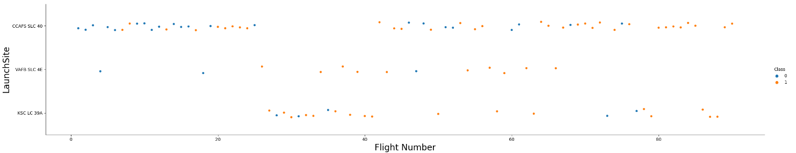
Flight Number vs. Launch Site
Launches from the site of CCAFS SLC 40 are significantly higher than launches from other sites

Slide 19
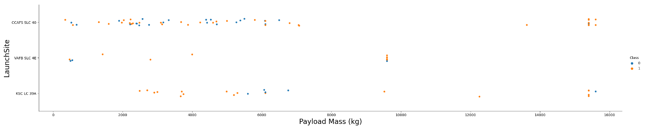
Payload vs. Launch Site
The majority of Pay Load with lower Mass have been launched from CCAFS SLC 40

Slide 20
Success Rate vs. Orbit Type
The orbit types of ES-L1, GEO, HEO, SSO are among the highest success rate.

Slide 21
Flight Number vs. Orbit Type
A trend can be observed of shifting to VLEO launches in recent years.

Slide 22
Payload vs. Orbit Type
There are strong correlation between ISS and Payload at the range around 2000, as well as between GTO and the range of 4000-8000.

Slide 23
Launch Success Yearly Trend
Launches success rate has increased significantly since 2013 and has stablised since 2019, potentially due to advance in technology and lesson learned.

Slide 24
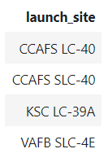
All Launch Site Names
%sql select Unique(LAUNCH_SITE) from SPACEXTBL

Slide 25
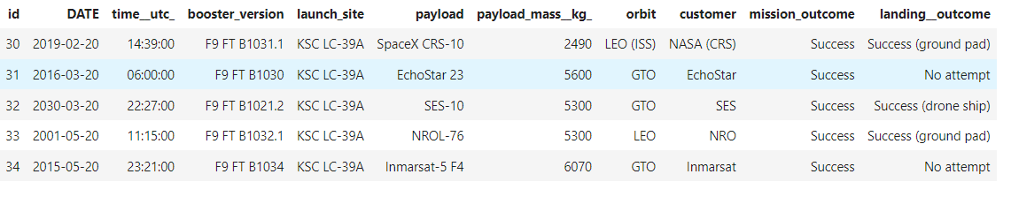
Launch Site Names Begin with 'KSC'
%sql SELECT * from SPACEXTBL where (LAUNCH_SITE) LIKE 'KSC%' LIMIT 5

Slide 26
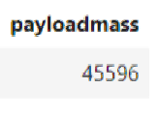
Total Payload Mass
%sql select sum(PAYLOAD_MASS__KG_) as payloadmass from SPACEXTBL

Slide 27
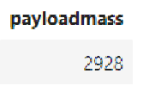
Average Payload Mass by F9 v1.1
%sql select avg(PAYLOAD_MASS__KG_) as payloadmass from SPACEXTBL WHERE BOOSTER_VERSION = 'F9 v1.1’

Slide 28
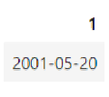
First Successful Ground Landing Date
%sql select min(DATE) from SPACEXTBL WHERE Landing__Outcome = 'Success (ground pad)’

Slide 29
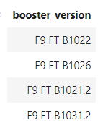
Successful Drone Ship Landing with Payload between 4000 and 6000
%sql select BOOSTER_VERSION from SPACEXTBL where LANDING__OUTCOME='Success (drone ship)' and PAYLOAD_MASS__KG_ BETWEEN 4000 and 6000

Slide 30
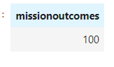
Total Number of Successful and Failure Mission Outcomes
%sql select count(MISSION_OUTCOME) as missionoutcomes from SPACEXTBL WHERE MISSION_OUTCOME = 'Success' or MISSION_OUTCOME = 'Failure (in flight)’

Slide 31
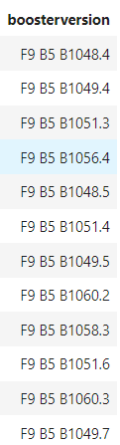
Boosters Carried Maximum Payload
%sql select BOOSTER_VERSION as boosterversion from SPACEXTBL where PAYLOAD_MASS__KG_=(select max(PAYLOAD_MASS__KG_) from SPACEXTBL)

Slide 32
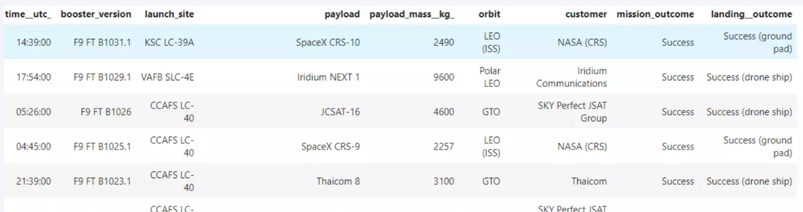
2015 Launch Records
%sql SELECT * FROM SPACEXTBL WHERE Landing__Outcome like ‘Success%’ and (DATE between ‘2015-01-01’ and ‘2015-12-31’ Order By DATE Desc;

Slide 33
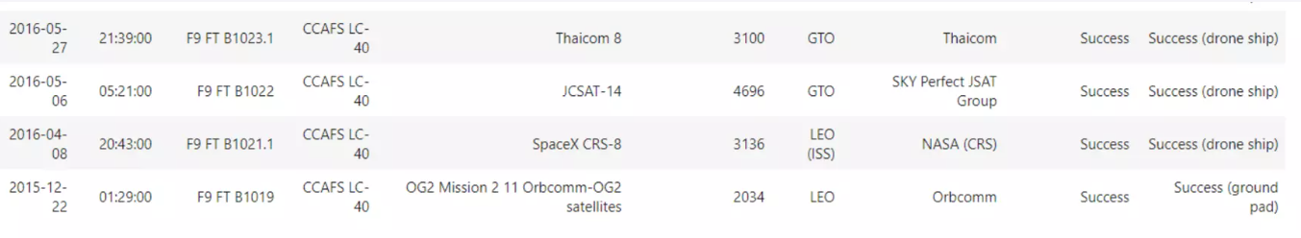
Rank Landing Outcomes Between 2010-06-04 and 2017-03-20
%sql SELECT * FROM SPACEX WHERE Landing__Outcome Like 'Success%' and (DATE BETWEEN '2010-06-04' AND '2017-03-20') ORDER BY date DESC;

Slide 34

Section 3

Slide 35
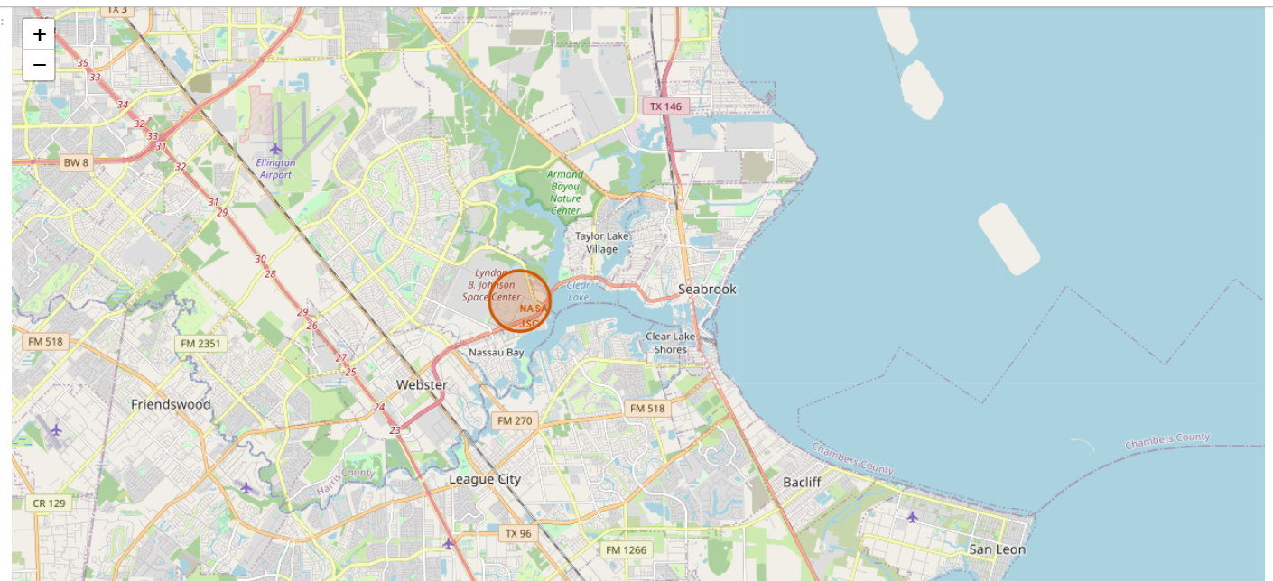
All launch sites marked on a map

Slide 36
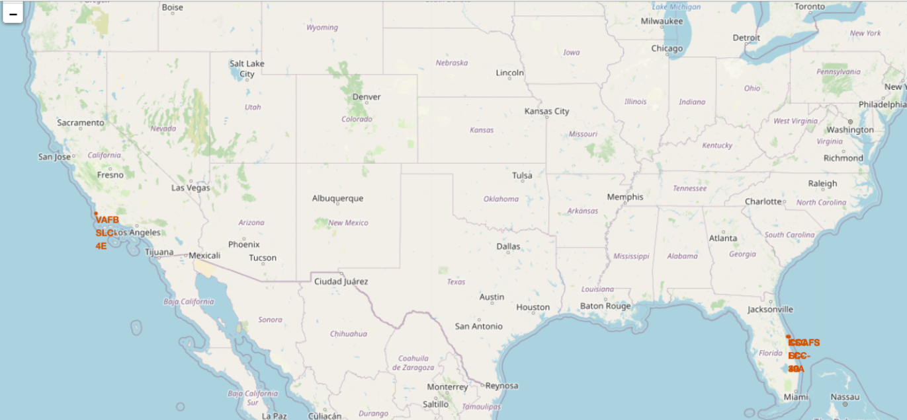
Success/Failed Launches marked on the Map

Slide 37
Distance between a launch site to its Proximities

Slide 38

Section 4

Slide 39
Total Success Launches by all Sites
We can see that KSC LC-39A had the most successful launches from all the sites

Slide 40
Success Rate by Site
KSC LC-39A achieved a 76.9% success rate while getting a 23.1% failure rate

Slide 41
Payload

Slide 42

Section 5

Slide 43
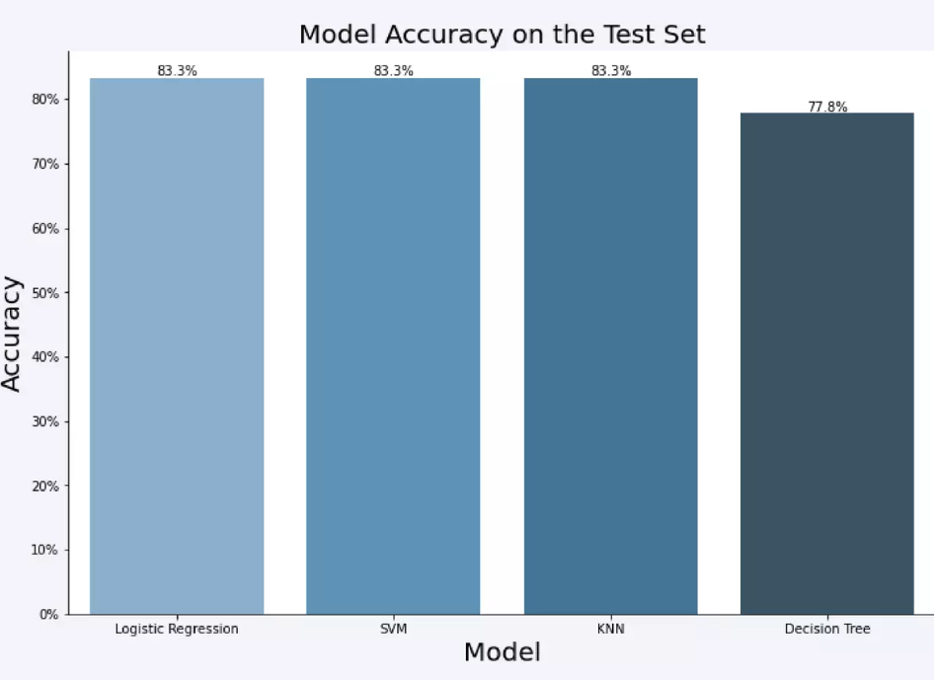
Classification Accuracy

Slide 44
Confusion Matrix

Slide 45
Conclusions
The SVM, KNN, and Logistic Regression models are the best in terms of prediction accuracy for this dataset.
Low weighted payloads perform better than the heavier payloads.
The success rates for SpaceX launches is directly proportional time in years they will eventually perfect the launches.
KSC LC 39A had the most successful launches from all the sites.
Orbit GEO,HEO,SSO,ES L1 has the best Success Rate.

Slide 46


